Slide 1

Introduction to Data Cleaning
Data cleaning ensures datasets are error-free and consistent. It improves analysis accuracy and delivers trustworthy insights
Identifying and fixing errors is essential before any data modeling or reporting.

Slide 2
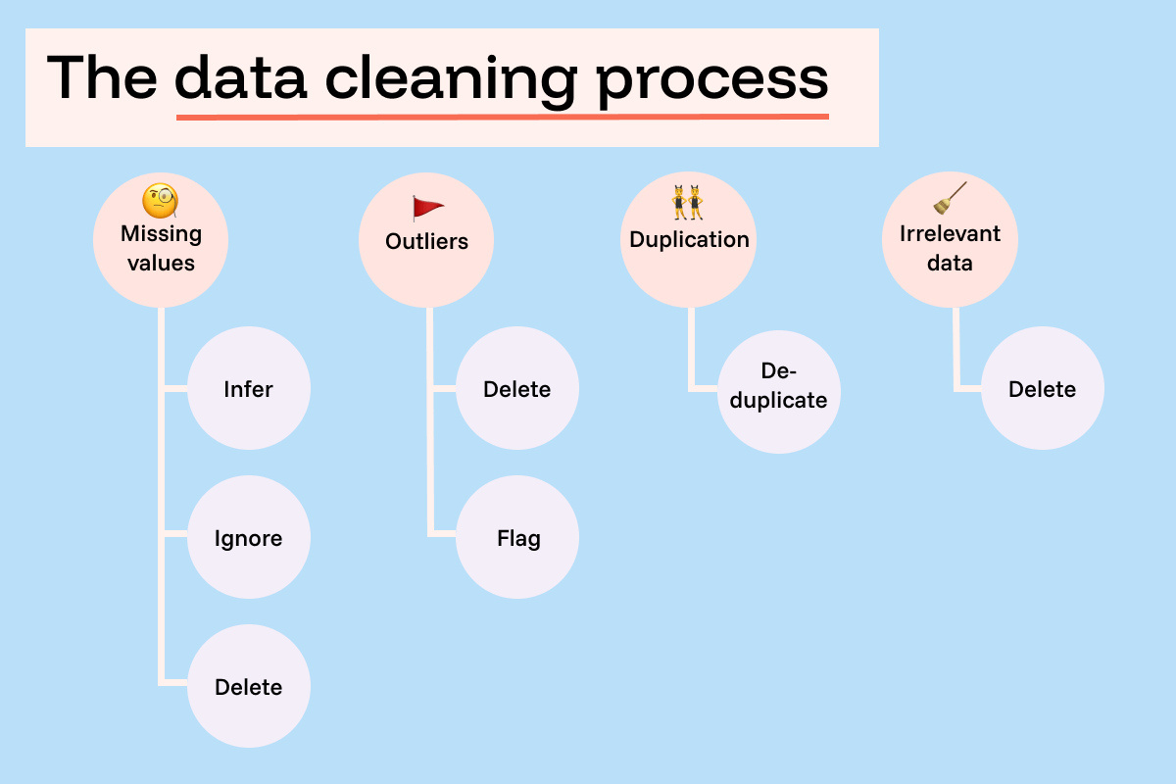
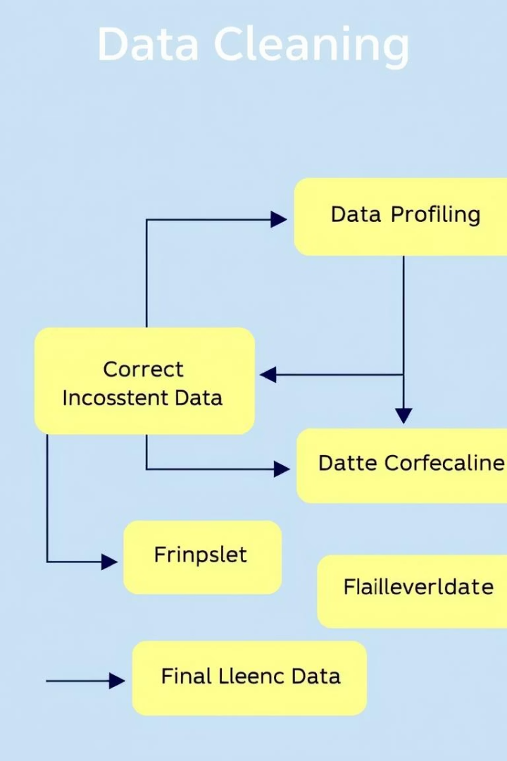

General Data Cleaning Workflow
1
Understand Data
Profile tables, columns, types, and relationships.
2
Identify Issues
Detect missing values, duplicates, inconsistencies.
3
Define Strategy
Plan how to handle each problem.
4
Implement & Verify
Apply fixes and validate cleaned data.

Slide 3

Understanding the Data: Profiling
Table Structure
Columns & Data Types
Note expected types and constraints per column
Examine all tables and their relationships
Value Distribution
Analyze unique values, patterns, and ranges.

Slide 4
Identifying Common Issues
Missing Values
Formatting
Nulls or blanks affecting analysis integrity
Inconsistent case, spaces, date formats.
Duplicates
Invalid Values
Redundant records causing bias or noise.
Out-of-range or logically incorrect data.
Wrong Types
Logical Errors
Data stored in incompatible formats.
Contradictory information like illogical dates.

Slide 5



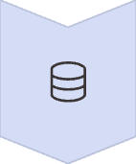

Defining a Cleaning Strategy
Keep
Accept valid data as is
Correct or Transform
Fix errors, standardize formats
Impute
Replace missing with calculated or constant values
Remove
Discard irreparable or harmful data

Slide 6

Implementing Cleaning Actions
Create Clean Versions
Do not overwrite raw data directly
Apply Corrections
Standardize formats, fix typos, convert types
Handle Missing Values
Use chosen imputation methods cautiously.
Remove Duplicates
Ensure unique, accurate records

Slide 7

Verification and Validation
Check Completeness
Validate Formats
Verify no new missing or duplicate data.
Ensure data types and formats are consistent.
Test Logical Consistency
Document Changes
Confirm business rules are respected.
Keep records for transparency and reproducibility.

Slide 8
Key Takeaways and Next Steps
Data Cleaning Improves Insights
Follow a Structured Workflow
Maintain Transparency
Continuously Monitor
Profiling, identifying, strategizing, implementing, verifying
Document cleaning steps for auditability
Keep data quality high over time
Accurate, reliable data leads to better decisions

